Slide 1
HW4 – CISC
NOP
Mark Dannemiller

Slide 2
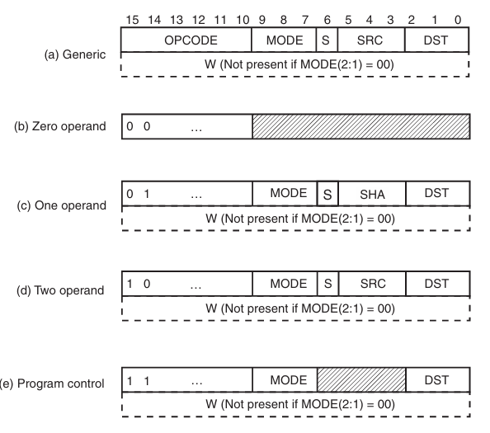
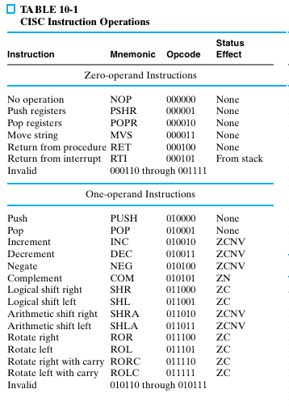

Slide 3
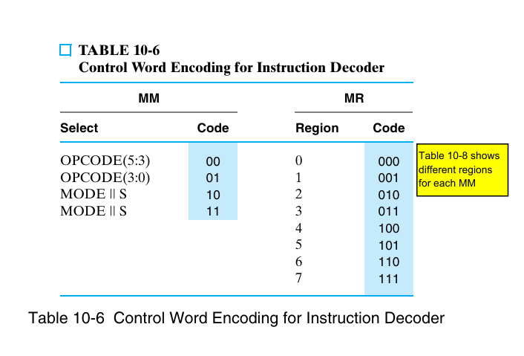
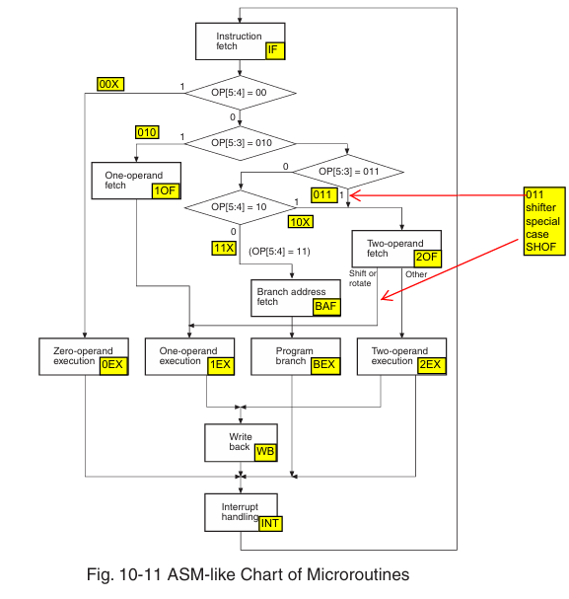
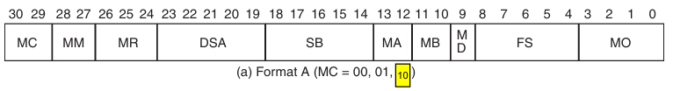
Microroutine
IF0 -> NOP fetched
IF1- > NOP decoded
0EX -> NOP and load INT0 in CAR
INT0
IF0
Microinstruction Format
MC | MM/LS | MR/PS | DSA/MS | SB | MA | MB | MD | FS/NA | MO
10 | 00 | 000 | 0000 | 00000 | 00 | 00 | 0 | 0000 | A

Slide 4
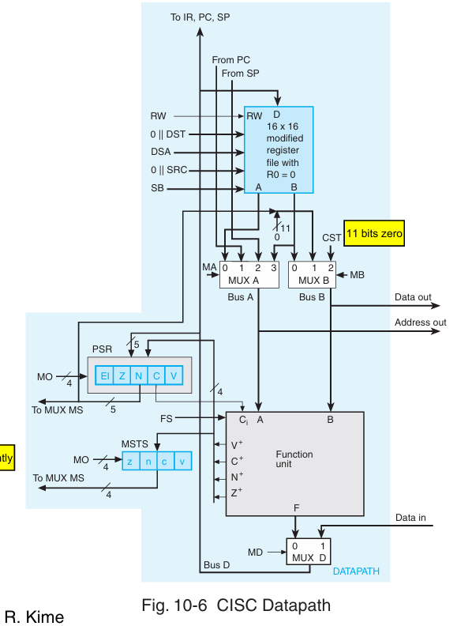
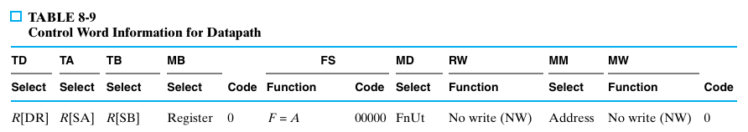
Datapath
MC | MM/LS | MR/PS | DSA/MS | SB | MA | MB | MD | FS/NA | MO
10 | 00 | 000 | 0000 | 00000 | 00 | 00 | 0 | 0000 | A
000
00
0

Slide 5
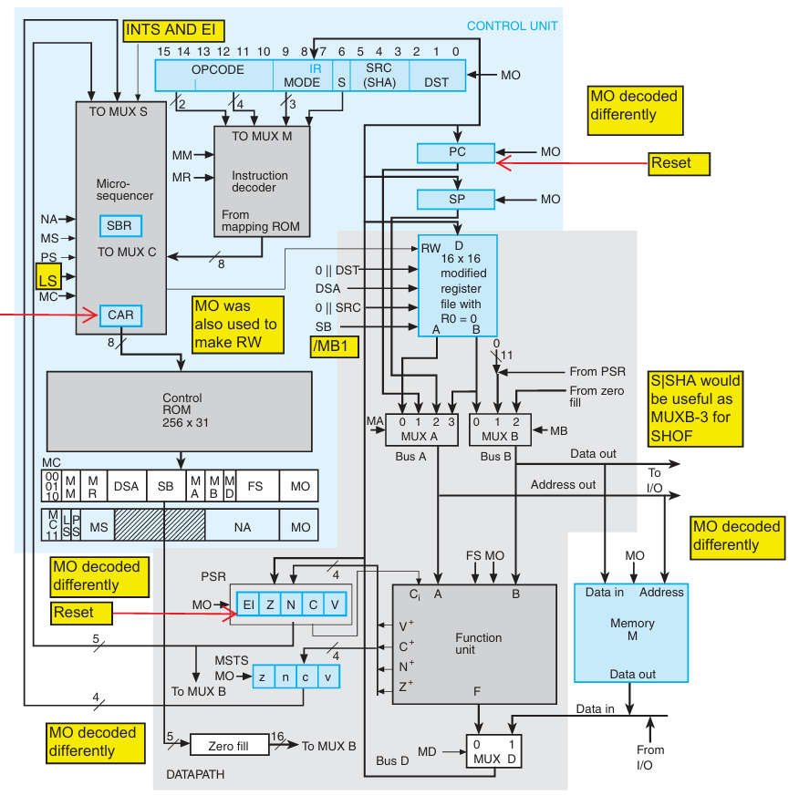
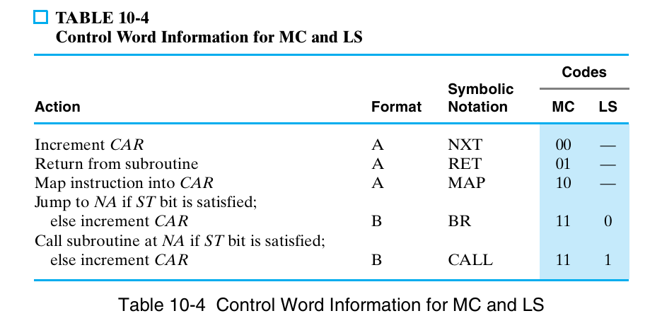

MC | MM/LS | MR/PS | DSA/MS | SB | MA | MB | MD | FS/NA | MO
10 | 00 | 000 | 0000 | 00000 | 00 | 00 | 0 | 0000 | A
000
Microroutine
IF0 -> NOP fetched
IF1- > NOP decoded
0EX -> NOP and load INT0 in CAR
INT0
IF0

